Slide 1
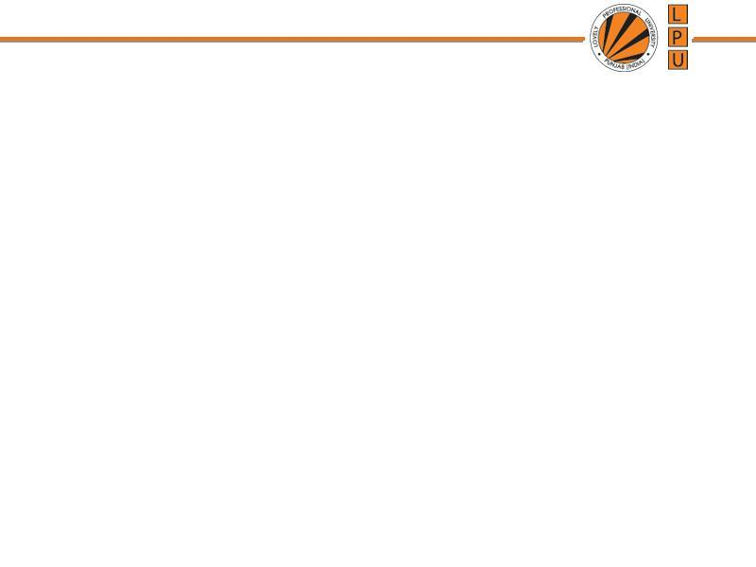
Chapter: CPU/ Process Scheduling
(Unit-2)

Slide 2
Basic Concept
CPU Scheduling is basis of Multi-programmed OS
Objective of Multi-programming is to have some processes running all the time to maximize CPU Utilization.

Slide 3
Sequence of CPU and I/O Bursts
CPU Burst- when process is executed in CPU
CPU Burst Time: The amount of time the process uses the processor
I/O Burst- when CPU is waiting for I/O completion for further execution.

Slide 4
Scheduling
Non-Preemptive
Preemptive

Slide 5
Non-Preemptive
Once the CPU is allocated to a process, process keeps the CPU until:
  it releases when it completes
  by switching to waiting state
  E.g : 1. Windows 3.x and Apple Macintosh operating systems uses non-preemptive scheduling
  2. Windows (also 10) uses a round-robin technique with a multi-level feedback queue for priority scheduling
Process is executed till completion. It cannot be interrupted.
Eg First In First Out

Slide 6
Preemptive Scheduling
The running process is interrupted for some time and resumed later on, when the priority task has finished its execution.
CPU /resources is/are taken away from the process when some high priority process needs execution.

Slide 7
Scheduling Criteria
Which algorithm to use in a particular situation
1. CPU Utilization: CPU should be busy to the fullest
2. Throughput: No. of processes completed per unit of time.
3. Turnaround Time: The time interval from submitting a process to the time of completion.
Turnaround Time= Time spent to get into memory + waiting in ready queue + doing I/O + executing on CPU
(It is the amount of time taken to execute a particular process)

Slide 8
Scheduling Criteria
4. Waiting Time: Time a process spends in a ready queue.
Amount of time a process has been waiting in the ready queue to acquire control on the CPU.
5. Response Time: Time from the submission of a request to the first response, Not Output
6. Load Average: It is the average number of processes residing in the ready queue waiting for their turn to get into the CPU.

Slide 9
Scheduling Algorithm Optimization Criteria
Max CPU utilization
Max throughput
Min turnaround time
Min waiting time
Min response time

Slide 10
Formula
Turn around time= Completion Time- Arrival Time
Waiting Time= Turn around Time-Burst Time
OR
Turnaround time = Burst time + Waiting time

Slide 11
First-Come, First-Served (FCFS)
Processes that request CPU first, are allocated the CPU first
It is non-preemptive scheduling algorithm
FCFS is implemented with FIFO queue.
A process is allocated the CPU according to their arrival times.
When process enters the ready queue, its PCB is attached to the Tail of queue, When CPU is free, it is allocated to the process selected from Head/Front of queue.

Slide 12
First-Come, First-Served (FCFS)
“Run until Completed:” FIFO algorithm
Example: Consider three processes arrive in order P1, P2, and P3.
  P1 burst time: 24
  P2 burst time: 3
  P3 burst time: 3
Draw the Gantt Chart and compute Average Waiting Time and Average Turn Around Time.
Sol: As arrival time is not given assume order of arrival as: P1,P2,P3

Slide 13
First-Come, First-Served (FCFS)
Example: Three processes arrive in order P1, P2, P3.
  P1 burst time: 24
  P2 burst time: 3
  P3 burst time: 3
Waiting Time
  P1: 0
  P2: 24
  P3: 27
Turnaround Time/Completion Time:
  P1: 24
  P2: 27
  P3: 30
Average Waiting Time: in milliseconds
Average Completion Time: in milliseconds
P1
P2
P3
0
24
27
30

Slide 14
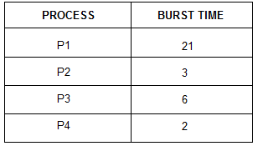
Example: First-Come, First-Served (FCFS)

Slide 15
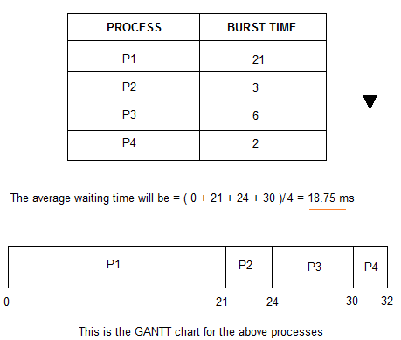
Example: First-Come, First-Served (FCFS)

Slide 16
(2) Shortest Job First
Processes with least execution time are selected first.
CPU is assigned to process with less CPU burst time.
SJF:
  Non-Preemption: CPU is always allocated to the process with least burst time and Process Keeps CPU with it until it is completed.
  Pre-Emption: When a new process enters the queue, scheduler checks its execution time and compare with the already running process.
  If Execution time of running process is more, CPU is taken from it and given to new process.

Slide 17
Shortest Job First(Preemptive)
Q1. Consider foll. Processes with A.T and B.T
Process A.T B.T
P1 0 4
P2 0 6
P3 0 4
Cal. Completion time, turn around time and avg. waiting time.
SJF(Pre-emptive)-> SRTF

Slide 18
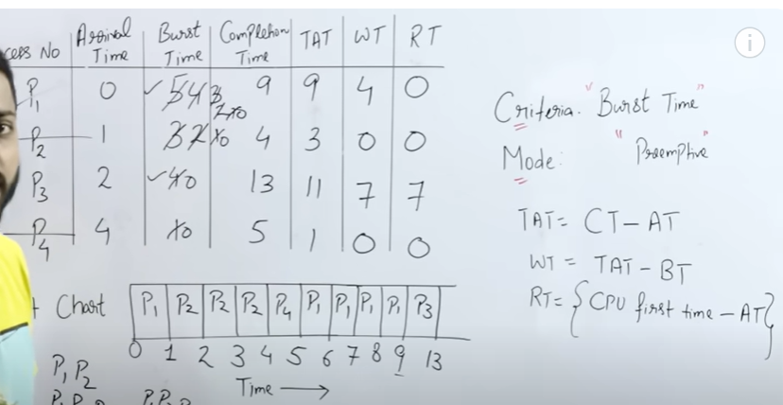
Shortest Remaining Time First.

Slide 19
Shortest Job First(Preemptive)
Q1. Consider foll. Processes with A.T and B.T
Process A.T B.T
P1 0 9
P2 1 4
P3 2 9
Cal. Completion time, turn around time and avg. waiting time.
SJF(Pre-emptive)-> SRTF

Slide 20
Shortest Job First(Preemptive)
Q1. Consider foll. Processes with A.T and B.T
Process A.T B.T
P1 0 5
P2 1 7
P3 3 4
Cal. Completion time, turn around time and avg. waiting time.
SJF(Pre-emptive)-> SRTF

Slide 21
H.W. Practice: Shortest Job First (Non Preemption)
Q1. Consider foll. Processes with A.T and B.T
Process A.T B.T
P1 1 7
P2 2 5
P3 3 1
P4 4 2
P5 5 8
Cal. Completion time, turn around time and avg. waiting time.
1.P1-> 8.P3->9.P4->11.P2->16.P5

Slide 22
Priority Scheduling
Priority is associated with each process.
CPU is allocated to the process with highest priority.
If 2 processes have same priority → FCFS
Disadvantage: Starvation (Low priority Processes wait for long)
Solution of Starvation: Aging
Aging: Priority of process is increased gradually (e.g after every 5 min priority is incremented by 1)

Slide 23
Consider the following table with AT, BT, Priority. Use Pre-emptive Priority Scheduling for calculating the Average waiting time.
Consider higher the number higher the priority
Priority | Process | A.T | B.T
10 | P1 | 0 | 5
20 | P2 | 1 | 4
30 | P3 | 2 | 2
40 | P4 | 4 | 1

Slide 24
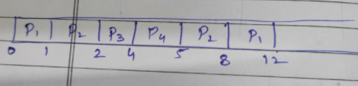
Priority | Process | A.T | B.T | C.T | TAT | W.T
10 | P1 | 0 | 5 | 12 | 12 | 7
20 | P2 | 1 | 4 | 8 | 7 | 3
30 | P3 | 2 | 2 | 4 | 2 | 0
40 | P4 | 4 | 1 | 5 | 1 | 0

Slide 25
Priority Scheduling (Preemptive)
Process | Arrival Time | Priority | Burst Time | Completion Time
P1 | 1 | 5 | 4
P2 | 2 | 7 | 2
P3 | 3 | 4 | 3
Consider 4 as Highest and 7 as Lowest Priority

Slide 26
Priority Scheduling (Preemptive)
Process | Arrival Time | Priority | Burst Time | Completion Time
P1 | 0 | 2 | 10
P2 | 2 | 1 | 5
P3 | 3 | 0 | 2
P4 | 5 | 3 | 20
Consider 0 as Lowest and 3 as Highest Priority

Slide 27
Round Robin Scheduling
A Time Quantum is associated to all processes
Time Quantum: Maximum amount of time for which process can run once it is scheduled.
RR scheduling is always Pre-emptive.

Slide 28
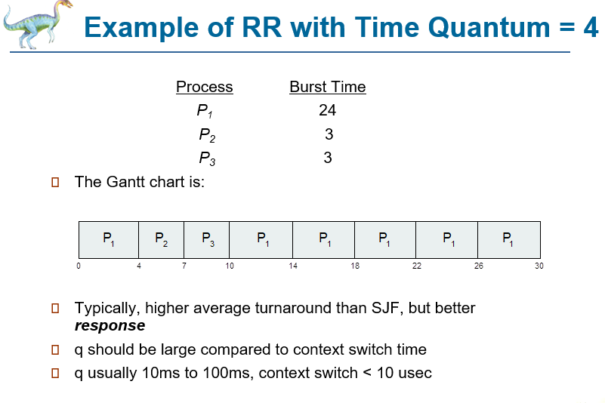

Slide 29
Round Robin
TQ: 2
Process | Arrival Time | Burst Time | Completion Time
P1 | 0 | 5 | 10
P2 | 1 | 7 | 13
P3 | 2 | 1 | 5
Process | Arrival Time | Burst Time | Completion Time
P1 | 0 | 3
P2 | 3 | 4
P3 | 4 | 6

Slide 30
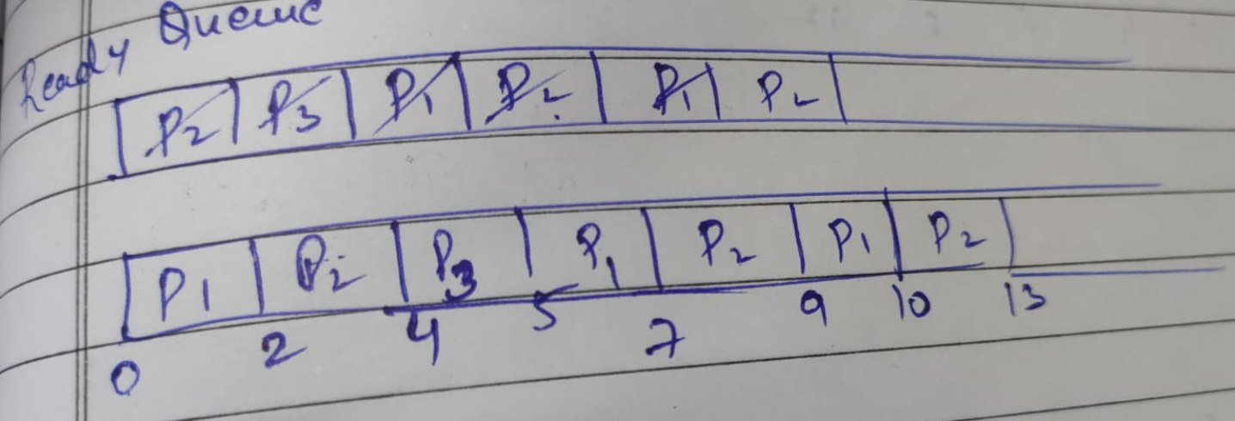

Slide 31
Round Robin
TQ: 2
Process | Arrival Time | Burst Time | Completion Time
P1 | 0 | 4 | 8
P2 | 1 | 5 | 18
P3 | 2 | 2 | 6
P4 | 3 | 1 | 9
P5 | 4 | 6 | 21
P6 | 6 | 3 | 19

Slide 32
Round Robin
TQ: 2
Process | Arrival Time | Burst Time | Completion Time
P1 | 0 | 4 | 8
P2 | 1 | 5 | 18
P3 | 2 | 2 | 6
P4 | 3 | 1 | 9
P5 | 4 | 6 | 21
P6 | 6 | 3 | 19
RQ: P1 P2 P3 P1 P4 P5 P2 P6 P5 P2 P6 P5

Slide 33
Multilevel Queue
A multilevel queue scheduling algorithm partitions the ready queue into several separate queues.
For Example: a multilevel queue scheduling algorithm with five queues, listed below in order of priority:
1. System processes
2. Interactive processes
3. Interactive editing processes
4. Batch processes
5. Student/ user processes

Slide 34
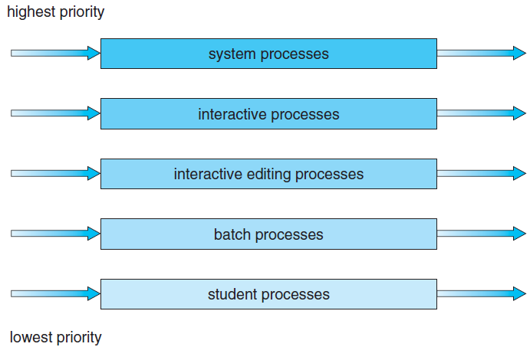
Multilevel Queue
FCFS
SJF
RR
If number of processes get increase in Highest priority Queue then lowest priority Queue will neve get turn and problem of starvation arise.

Slide 35
Multilevel Queue
Processes can be :
  Foreground Process: processes that are running currently → RR Scheduling is applied
  Background Process: Processes that are running in the background but its effects are not visible to user. →FCFS
Multilevel queue scheduling divides ready queue into several queues.
Processes are permanently assigned to one queue on some property like memory size, process priority, process type.
Each queue has its own scheduling algorithm

Slide 36
Practice: Multilevel Queue
Process | Arrival Time | Burst Time | Queue
P1 | 0 | 4 | 1
P2 | 0 | 3 | 1
P3 | 0 | 8 | 2
P4 | 10 | 5 | 1
Priority of queue 1 is greater than queue 2. queue 1 uses Round Robin (Time Quantum = 2) and queue 2 uses FCFS.

Slide 37


Slide 38
Multilevel Queue
As different type of processes are there so all cant be put into same queue and apply same scheduling algorithm.
Disadvantages:
Until high priority queue is not empty, No process from lower priority queues will be selected.
Starvation for lower priority processes
Advantage:
Can apply separate scheduling algorithm for each queue.

Slide 39
Multilevel Feedback Queue
Solution is: Multilevel Feedback Queue
If a process is taking too long to execute.. Pre-empt it send it to low priority queue.
Don’t allow a low priority process to wait for long.
After some time move a least priority process to high priority queue → Aging

Slide 40
Multilevel Feedback Queue
Allows a process to move between queues.
The idea is to separate processes according to the characteristics of their CPU bursts.
If a process uses too much CPU time, it will be moved to a lower-priority queue.
This scheme leaves I/O-bound and interactive processes in the higher-priority queues.
In addition, a process that waits too long in a lower-priority queue may be moved to a higher-priority queue. This form of aging prevents starvation.

Slide 41
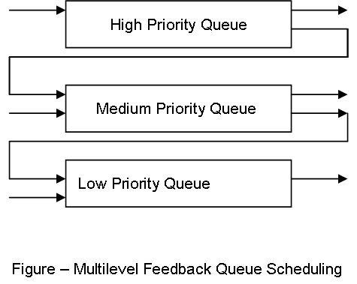
Multilevel Feedback Queue

Slide 42
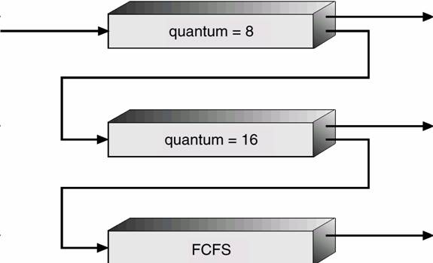
Multilevel Feedback Queue

Slide 43
Multi-processor Scheduling
Concerns:
If multiple CPUs are available, load sharing becomes possible.
  Concentration is on systems in which the processors are identical—homogeneous in terms of their functionality.
  Use any available processor to run any process in the queue
  There are also different types of limitations:
  A system with an I/O device attached to a private bus of one processor. Processes that wish to use that device must be scheduled to run on that processor

Slide 44
Approaches to Multiple-Processor Scheduling
1. Asymmetric multiprocessing
All scheduling decisions, I/O processing, and other system activities handled by a single processor—the master server. The other processors execute only user code.
Only one processor accesses the system data structures, reducing the need for data sharing.

Slide 45
Approaches to Multiple-Processor Scheduling
2. Symmetric multiprocessing (SMP)
Each processor is self-scheduling.
All processes may be in a common ready queue, or each processor may have its own private queue of ready processes.
Scheduling proceeds by having the scheduler for each processor examine the ready queue and select a process to execute.
Virtually all modern operating systems support SMP, including Windows, Linux, and Mac OS X

Slide 46
Real Time Scheduling
Analysis and testing of the scheduler system and the algorithms used in real-time applications
a) soft real-time systems b) hard real-time systems
Soft real-time systems provide no guarantee as to when a critical real-time process will be scheduled. They guarantee only that the process will be given preference over noncritical processes.
Hard real-time systems have stricter requirements. A task must be serviced by its deadline;
Service after the deadline has expired is the same as no service at all.

Slide 47
Rate-Monotonic Scheduling
The rate-monotonic scheduling algorithm schedules periodic tasks using a static priority policy with preemption.
rate-monotonic scheduling (RMS) is a priority assignment algorithm used in real-time operating systems (RTOS) with a static-priority scheduling class.
The static priorities are assigned according to the cycle duration of the job, so a shorter cycle duration results in a higher job priority

Slide 48
Rate-Monotonic Scheduling
If a lower-priority process is running and a higher-priority process becomes available to run, it will preempt the lower-priority process.
Upon entering the system, each periodic task is assigned a priority inversely based on its period. The shorter the period, the higher the priority; the longer the period, the lower the priority.
Assign a higher priority to tasks that require the CPU more often (less)

Slide 49
Earliest Deadline First Scheduling
Earliest-deadline-first (EDF) scheduling dynamically assigns priorities according to deadline.
The earlier the deadline, the higher the priority the later the
deadline, the lower the priority.
Under the EDF policy, when a process becomes runnable, it must announce its deadline requirements to the system. Priorities
may have to be adjusted to reflect the deadline of the newly runnable process.

